Slide 1
More ideas for Social Emotional Learning at Home 3rd-5th!
Created by: Hilary Ramirez (School Counselor)
and Megan Gross (SAI Teacher on Special Assignment)

Slide 2
Activity 1
“The only way to have a friend is to be one.”- Ralph Waldo Emerson

Slide 3
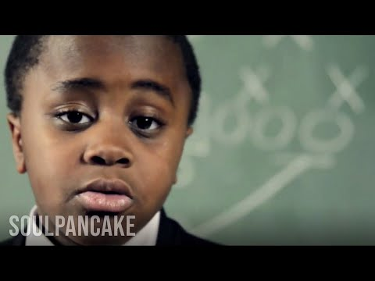
Kid President
*What does the saying “I took the road less traveled mean?”
*Think about...How often are you provided two paths of choices?
*What are some of your goals for the future? What are the obstacles and different paths you might face when trying to reach your goal?
*Who is someone you look up to and why?
ACTIVITY IDEA: Create a video, skit, dance video, comic strip etc. to inspire others!

Slide 4
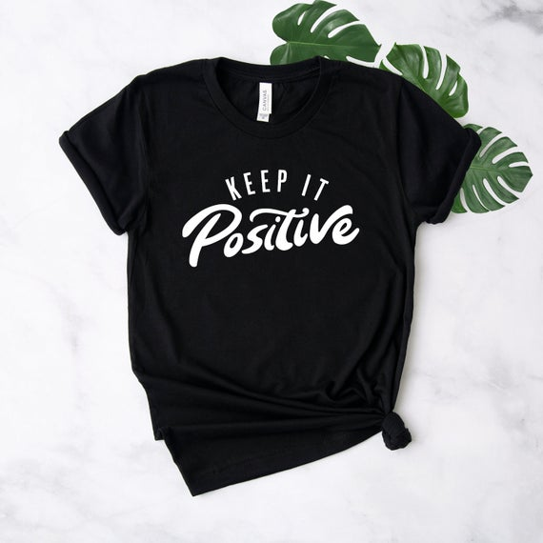
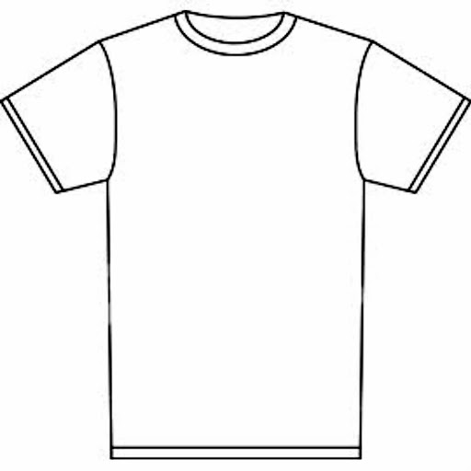
Positive T Design
Activity: Create a T-Shirt design to show kindness, friendship, positivity, and/or acceptance!
Use your creativity!

Slide 5
Activity 2
“The more that you read, the more things you will know. The more that you learn, the more places you’ll go.” – Dr. Seuss

Slide 6
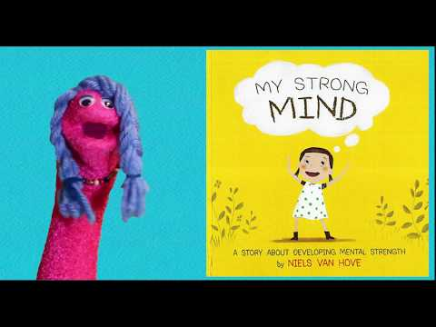
My Strong Mind
By: Niels Van Hove
Think about:
How do you make your mind stronger everyday?
What is a challenge that you are going through right now?
Tell yourself 5 things that you love about yourself.
(confidence in yourself helps build your mind stronger)
What are some things we can do at home to strengthen our mind and body?

Slide 7
Activity 3
“You always pass failure on the way to success.” -Mickey Rooney

Slide 8
Mindfulness Choice Board
Practice all of these Mindfulness breathing techniques:
*Which one did you feel the most calm with?
*When can you use these techniques at home and at school?
ACTIVITY: Teach someone in your house one of these techniques.
ACTIVITY: Create your own mindfulness breathing technique.

Slide 9
Activity 4
“Do what you can, with what you have, where you are.” – Theodore Roosevelt

Slide 10
Rosie Revere, Engineer
By: Andrea Beaty

Slide 11
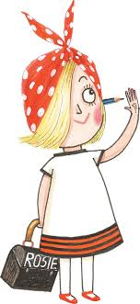
Being an Engineer
Now that you learned about Rosie Revere the Engineer how can you be an engineer/inventor at home:
Things to think about:
*What is the name of your invention?
*What problem does your invention serve?
*What materials did you use to create your invention?
*How does your invention work?
*What is your favorite thing about your invention?

Slide 12
LEGO Creations
Now that you learned about Rosie Revere the Engineer with LEGOs or Building materials:
*Create a playground structure.
*Create a new invention to help your family with chores.
*Build an animal habitat.
*Be creative and make something new.

Slide 13
Activity 5
“We grow great by dreams.”-Woodrow Wilson

Slide 14
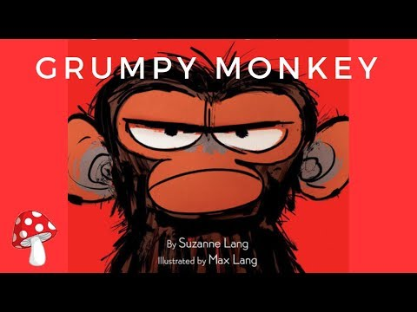
Grumpy Monkey
By: Suzanne Lang
Questions:
Did Jim know he was grumpy?
What does it mean that Jim didn’t feel happy inside?
What did Jim do so he wouldn’t look grumpy?
Did Jim like the singing birds?
What are some coping skills you can use if you are feeling grumpy?

Slide 15
Activity 6
“Make each day your masterpiece.” – John Wooden

Slide 16
What if Everybody Did That?
By: Colleen M. Madden
Questions:
What if everybody broke the rules at school?
What if everybody didn’t show kindness? What if everybody did?
What are ways that we can show kindness/community while learning from home?
ACTIVITY: Create a story that is similar to What if Everybody did That, but with showing kindness and positive choices.

Slide 17
Activity 7
“No one is perfect – that’s why pencils have erasers.” – Wolfgang Riebe

Slide 18
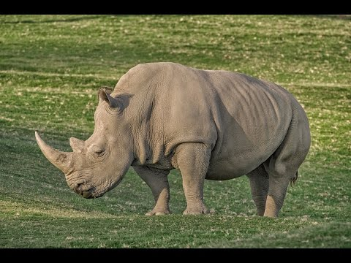
San Diego Zoo Rhinos
Think about:
*What is something new you learned from this video?
*Do you think animals experience emotions also?
*What are the similarities and differences of Rhinos and humans?
*What is your favorite animal and why?
*How can animals help humans when we have strong emotions?

Slide 19
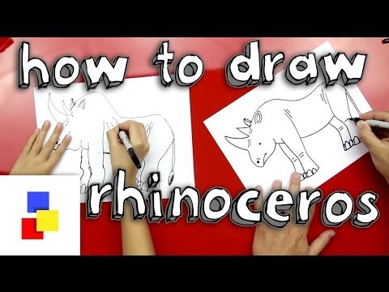
Rhino Draw Along
Please remember this is a fun activity. Do your best and have fun.

Slide 20
Activity 8
“We all can dance when we find music we love.” – Giles Andreae

Slide 21
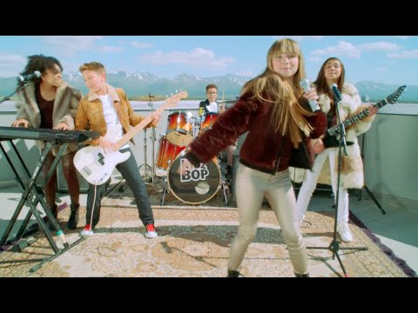
Happy
By: Pharrell Williams/Kids Bop
Watch/Listen to this song
*What feeling do you feel when listening to this song?
*Did it make you want to dance or move?
*Why is happiness important for everyone?
*How can we tell/show people that we are happy?
ACTIVITY: Make a list of your favorite songs and next to it add the emotion you feel when you hear it!

Slide 22
Activity 9
“Why fit in when you were born to stand out?” – Dr. Seuss

Slide 23
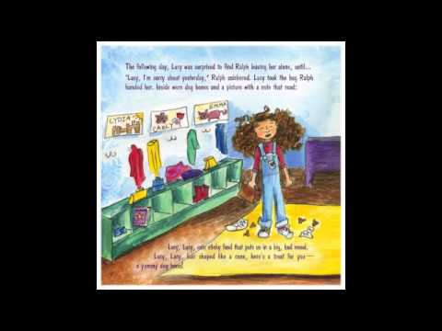
Spaghetti In a Hot Dog Bun
By: Maria Dismondy
What is your favorite food?
Would you eat spaghetti in a hot dog bun?
ACTIVITY: As a household make a list of the foods that everyone likes on the left, and a list of the foods that we feel differently about on the right. Lets see which side has more!?
ACTIVITY: Draw a new cover of this book with YOUR favorite food in a hot dog bun. Then, share your picture with your family and ask what food they would bring to school in a hot dog bun!

Slide 24
Activity 10
“It’s not what happens to you, but how you react to it that matters.” – Epictetus

Slide 25
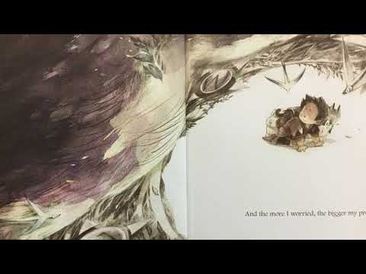
What to do with a Problem?
By:Kobi Yamada
When we are faced with problems we all respond differently. Some problems are expected (planned for) but others are unexpected (no time to plan).
What is a problem that you are facing currently that was expected?
What is a problem that you are facing currently that was unexpected?
What are your multiple options of solving the problem?
Think about what would happen for each of the solutions you wrote above?
In what ways can we help others when they are being faced with a problem?

