Slide 1
More ideas for Social Emotional Learning at Home K-2nd!
Created by: Hilary Ramirez (School Counselor)
and Megan Gross (SAI Teacher on Special Assignment)

Slide 2
Activity 1
“The only way to have a friend is to be one.”- Ralph Waldo Emerson

Slide 3
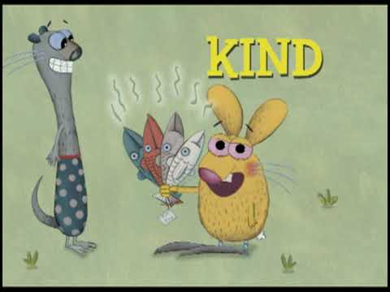
Do Unto Otters
By: Laurie Keller
We can practice the Golden Rule with the people in our home.
Be friendly: Say “Good morning!” or “How are you?”
Be polite: Use a inside voice
Be honest: Tell the truth
Be kind: Use nice words
Share: Play together with your siblings
Help each other: Help clean up or pick up your toys
What else can you do?

Slide 4
Activity 2
“It’s not what happens to you, but how you react to it that matters.” – Epictetus

Slide 5
Stick and Stone
By: Beth Ferry and Tom Lichtenheld
Before you watch:
Predict what you think it will be about.
After you watch:
Why did Stick and Stone become friends?
What does it mean to stick up for someone?
What kind of friend is pinecone?
What does the phrase “Stick, Stone. A perfect 10,” mean?
ACTIVITY: Draw a picture of yourself helping a friend.

Slide 6
Activity 3
“The more that you read, the more things you will know. The more that you learn, the more places you’ll go.” – Dr. Seuss

Slide 7
The Good Egg
By: Jory John
The Good Egg reminds us we don’t have to be perfect and neither do the people in our house!
Try out one of the Good Egg’s ideas for feeling better!
Take deep breaths
Paint or draw a picture
Play outside

Slide 8
Activity 4
“We all can dance when we find music we love.” – Giles Andreae

Slide 9
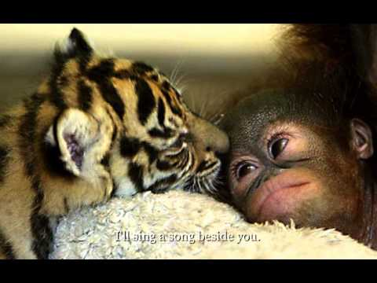
Count on Me
By: Bruno Mars
Help your friends count on you, even when we have to stay home!
Think about: How does this song and video make you feel?
Count on me:
Draw pictures to post in your window. Friends on a walk can look for them.
Draw a card for a friend.
Ask an adult to help you call a friend to say hello!

Slide 10
Activity 5
“You always pass failure on the way to success.” -Mickey Rooney

Slide 11
Mindful Breathing Techniques
When you are feeling sad, excited, nervous, or if you need to calm down.
Find a quiet location.
Practice these 3 mindful techniques.
Think about how your body feels when you are practicing these mindful breathing techniques.
Which one was your favorite? Once you have picked one, teach one of your family members how to practice this breathing technique.

Slide 12
Activity 6
“Why fit in when you were born to stand out?” – Dr. Seuss

Slide 13
My Many Colored Days
By: Dr. Seuss
Questions:
What is your favorite color? And why?
What color would you choose to explain being sad?
What color would you choose to explain being happy?
What color would you choose to explain being frustrated?
What color would you choose to explain being excited?

Slide 14
Activity 7
“Make each day your masterpiece.” – John Wooden

Slide 15
The Dot
By: Peter H. Reynolds
ACTIVITY:
With someone in your house listen to the book and then both of you take a piece of paper and put a dot on your paper (think of it as a mistake). Now from that dot draw something.
A dot can lead to amazing things.

Slide 16
Activity 8
“Do what you can, with what you have, where you are.” – Theodore Roosevelt

Slide 17
Rosie Revere, Engineer
By: Andrea Beaty

Slide 18
Being an Engineer
Now that you learned about Rosie Revere the Engineer how can you be an engineer/inventor at home:
Things to think about:
*What is the name of your invention?
*What problem does your invention serve?
*What materials did you use to create your invention?
*How does your invention work?
*What is your favorite thing about your invention?

Slide 19
LEGO Creations
Now that you learned about Rosie Revere the Engineer with LEGOs or Building materials:
*Create a playground structure.
*Create a new invention to help your family with chores.
*Build an animal habitat.
*Be creative and make something new.

Slide 20
Activity 9
“We grow great by dreams.”-Woodrow Wilson

Slide 21
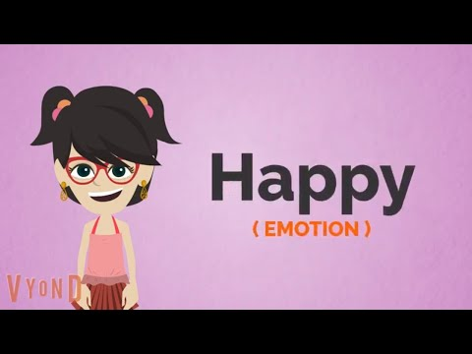
Emotions Charades
Now that you know how to read someone else’s body language. Write down a list of 10 emotions and play Emotions Charades with your family at dinner.
How to play: You act out an emotion and your family members need to guess. This can sometimes be tricky because there are many different emotions!

Slide 22
Activity 10
“No one is perfect – that’s why pencils have erasers.” – Wolfgang Riebe

Slide 23
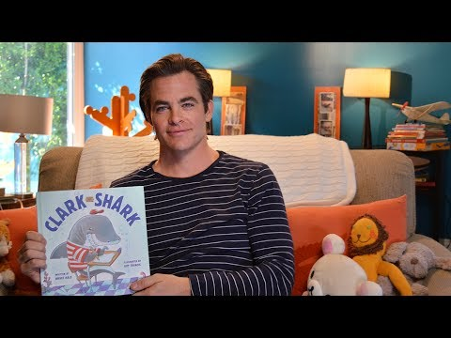
Clark the Shark
By:Bruce Hale
Clark has to learn there’s a time and place for everything.
Do you have rules in your class?
Do you have rules in your home?
Think about a time when you have been too loud or wild at home. What happened?
What rules do you have at home to help everyone get along during our school closure?

